Slide 1
Cement Demand Prediction Algorithms and Data Structures for Artificial Intelligence
Instructor:
Dr. Beakal Gizachew
Team Members
Sintayehu Zekarias
Fikir Awoke
Ashenafi Kifleyohans

Slide 2
Outline
Statement of the problem
Objective
Methodologies
Conclusion
Result and Evaluation

Slide 3
Statement of the problem
The company practices a traditional prediction system using spreadsheets which makes it difficult to deal with the big data.
The traditional prediction system does not give an accurate result
The company collects cement demand from customers to predict stock level for the coming sales

Slide 4
Objective
General Objective
The main objective of this project is to predict the cement stock level demand according to previous sales data using Machine learning algorithms.
Requirement understanding
Data Collection and Exploration
Data Preparation and Preprocessing
Algorithm Implementations
Model Selection
Training and Performance Evaluation
Specific Objective

Slide 5
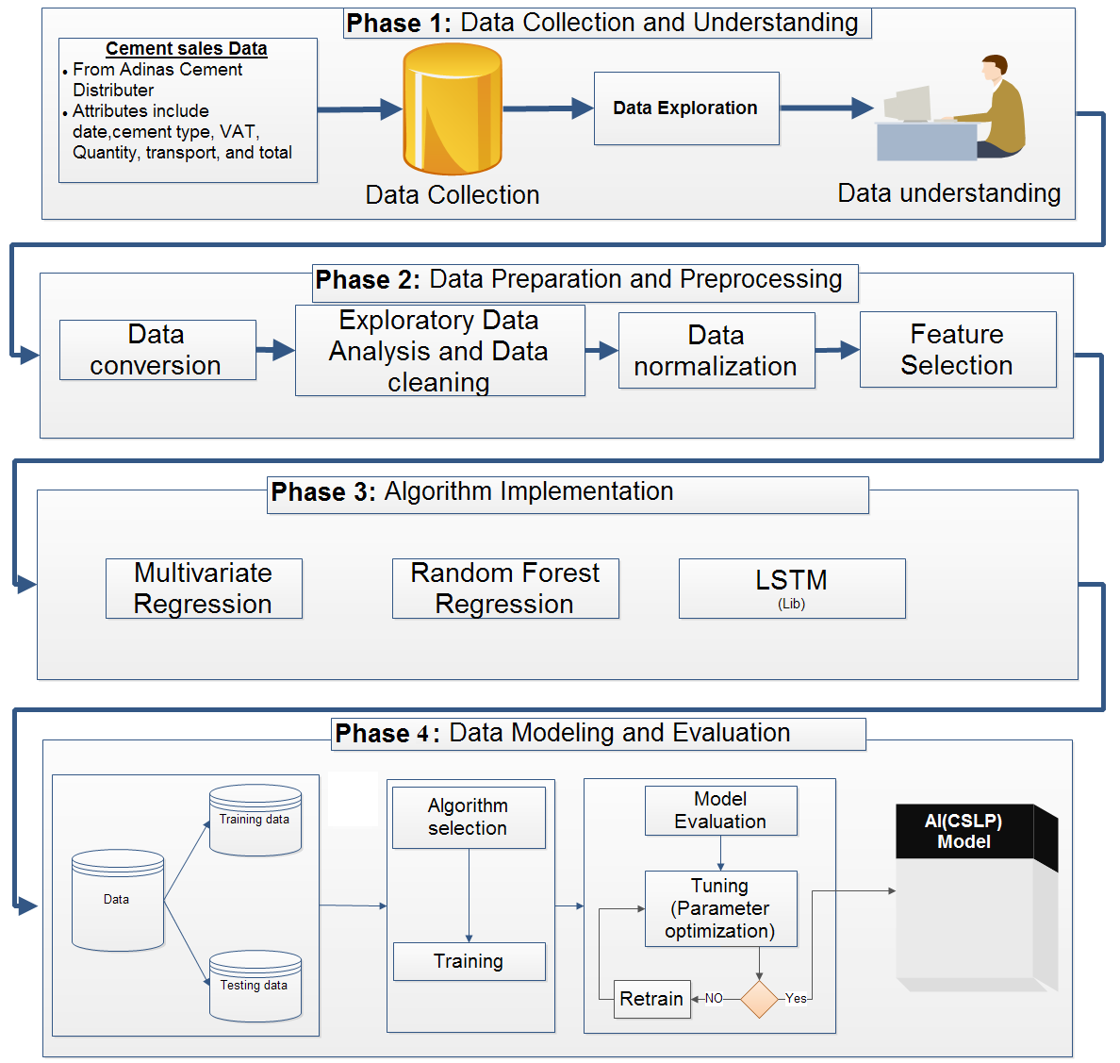
Methodologies

Slide 6
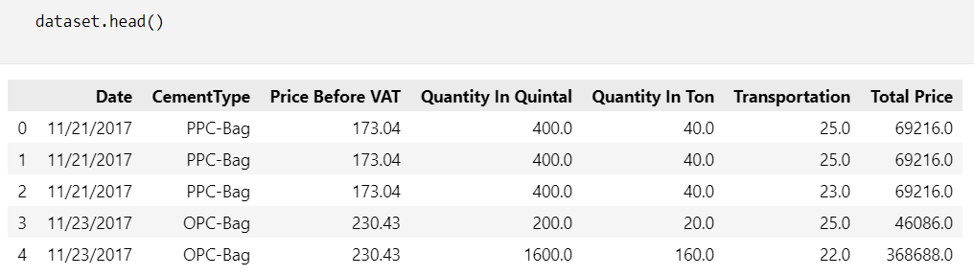
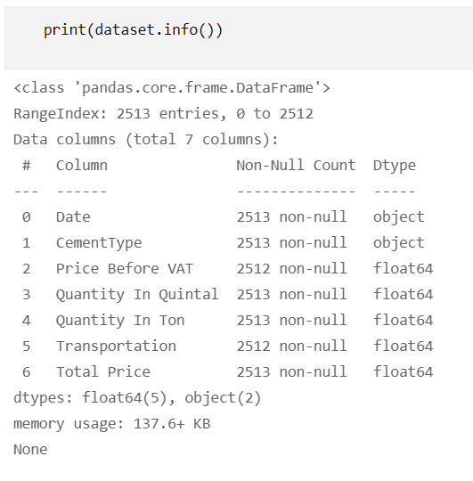
Data Collection and Exploration
We collected 2513 cement sales data from Adinas Cement Distributor from 2017-2022.

Slide 7
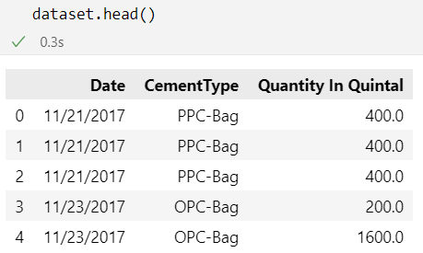
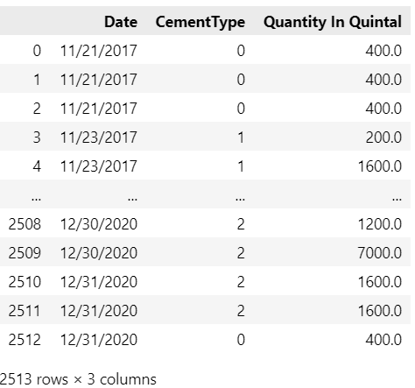
Data Preparation and Preprocessing
We removed the unnecessary attributes from the dataset, this are Price Before VAT, Quantity In Ton, Transportation and Total Price
Under feature engineering, we performed the following tasks
Generate unique number for each cement type
Replace cement type to numeric value

Slide 8
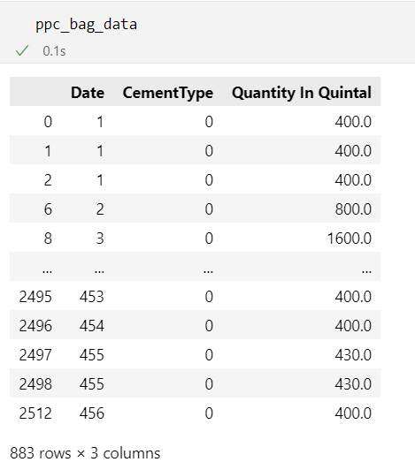
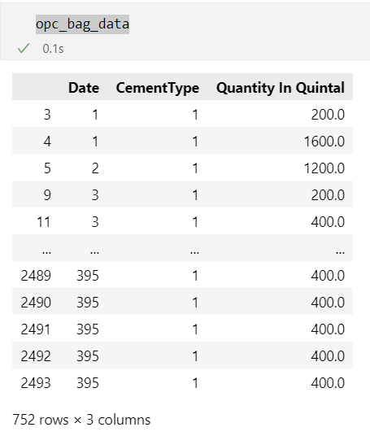
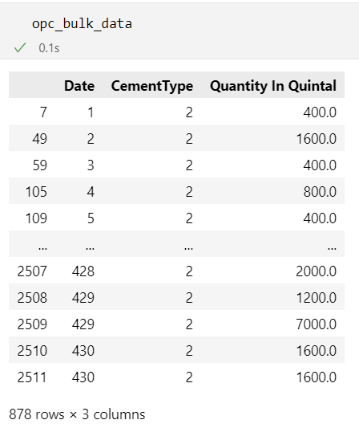
Data Preparation and Preprocessing
Filter Cement type from dataset and store it to ppc_dataset, opc_bulk_dataset, opc_bag_dataset
Under feature engineering, we performed the following tasks
Generate unique number for each date
Replace date to numeric value

Slide 9
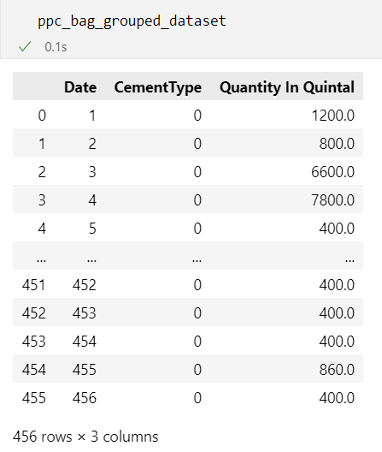
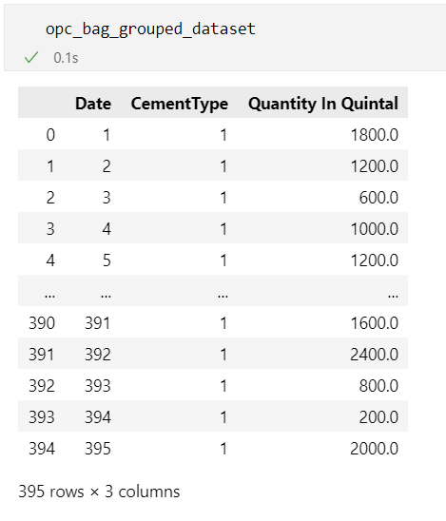
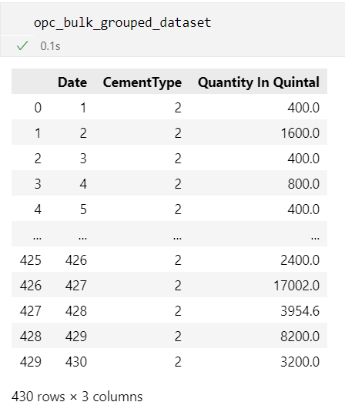
Data Preparation and Preprocessing
Adding cement types having the same date

Slide 10
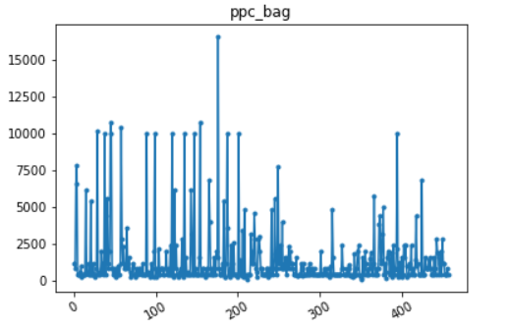
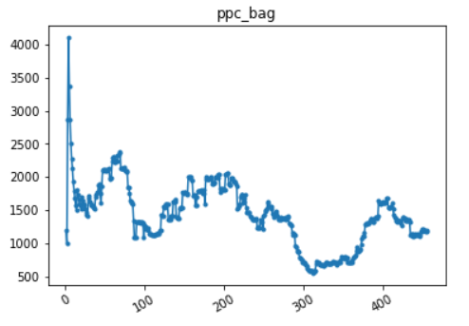
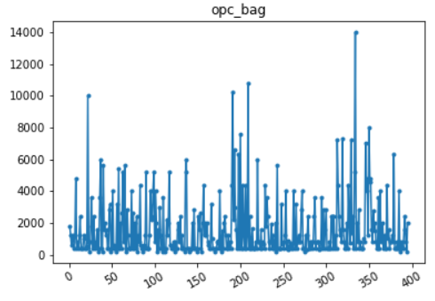
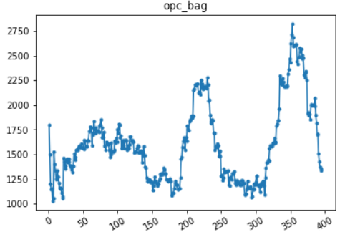
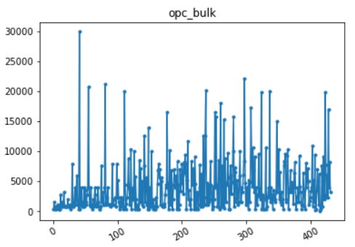
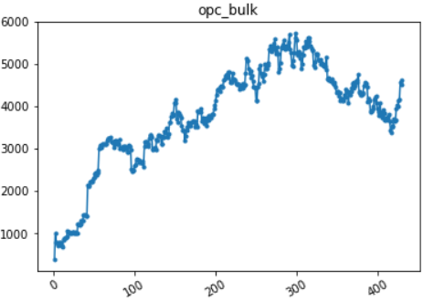
Data Preparation and Preprocessing Exploratory Data Analysis (EDA)
Before smoothing
After smoothing

Slide 11
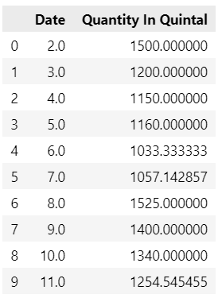
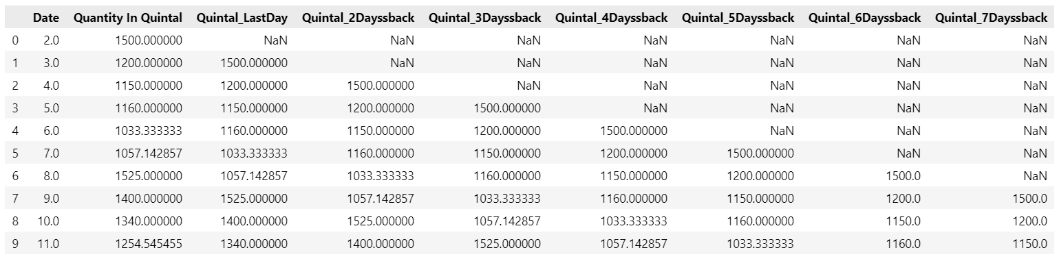
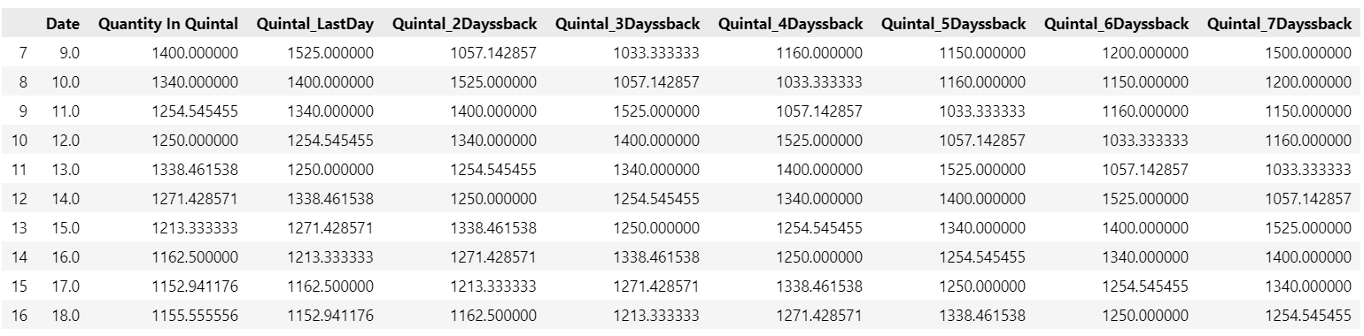
Data Preparation and Preprocessing
Prepared input data from Quantity In Quintal for time series forecasting, to do this we used the past seven days(a one week) data to make a prediction for today .

Slide 12
Model selection
We selected the following Machine Learning Models to train, test and make prediction.
Linear (Multivariate ) regression
Random forest regression
Long Short Term Memory(LSTM) for regression
Split features and labels from cement type sales dataset-(80/20)
Train and test the algorithms

Slide 13
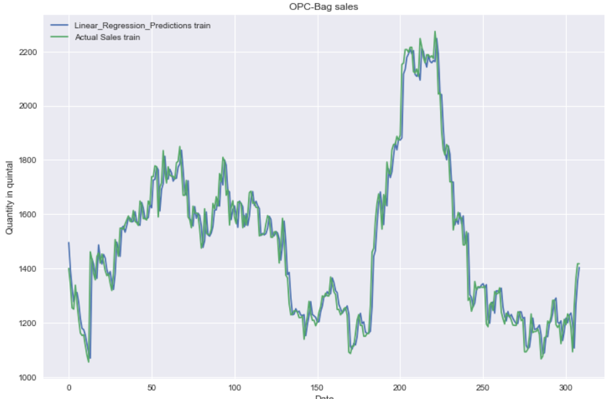
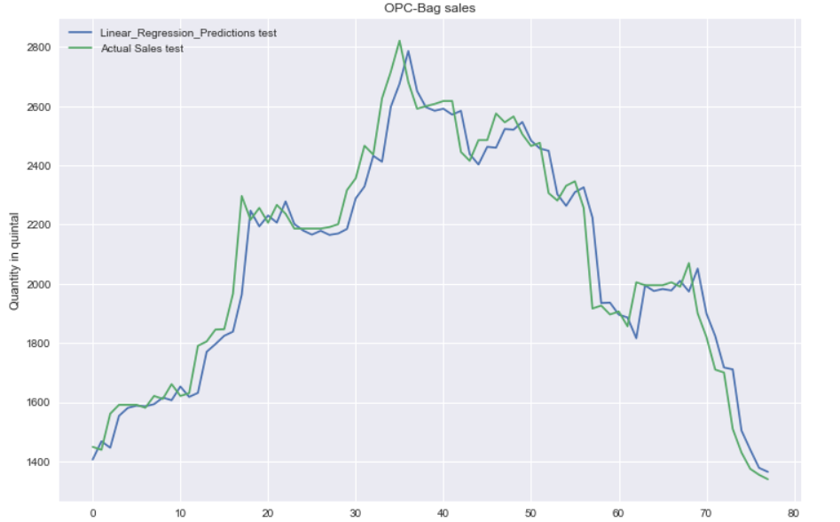
Result-For OPC Bag

Slide 14
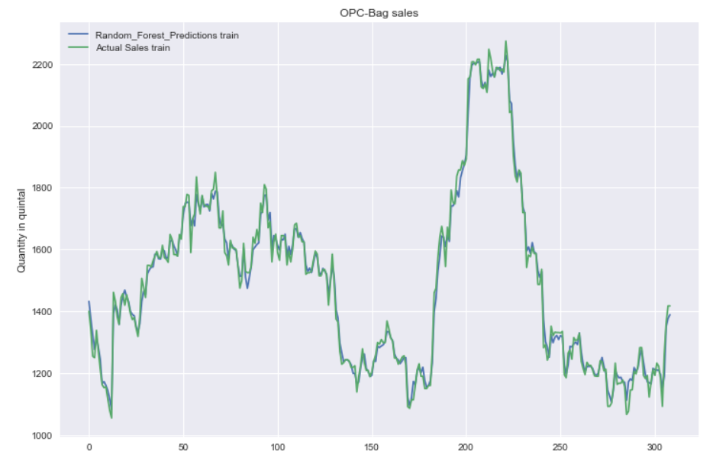
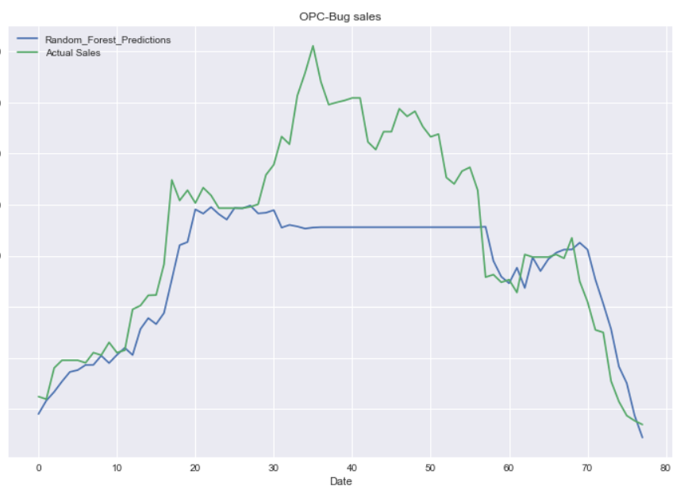
Result-For OPC Bag

Slide 15
Result-For OPC Bag

Slide 16
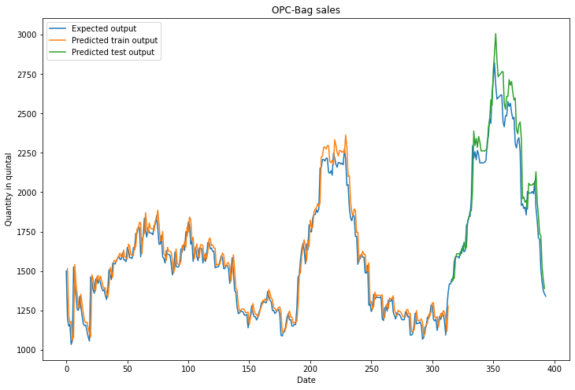
Result-For OPC Bag

Slide 17
Result and Performance Evaluation
As our project is a regression problem to measure the evaluation metrics we used the following
Root Mean Square Error (RMSE),
Mean Absolute Error (MAE)
Mean Square Error (MSE)
Cement Type | Random forest regressor |  |  | Multivariate regression |  |  | Long short term memory
 | RMSE | MSE | MAE | RMSE | MSE | MAE | RMSE | MSE | MAE
OPC Bag | 487.47 | 237626.65 | 402.70 | 91.08 | 8295.38 | 62.66 | 130.09 | 16922.67 | 99.41
OPC Bulk | 466.64 | 217755.78 | 378.03 | 132.35 | 7516.37 | 99.84 | 157.34 | 24756.31 | 131.53
PPC Bag | 299.37 | 89628.27 | 236.19 | 51.77 | 2679.83 | 32.09 | 52.40 | 2745.56 | 34.10

Slide 18
Conclusion
Based on our implementation the comparative analysis in RMSE, MSE and MAE values indicates that Multivariate repressor has a better prediction as compared to the other models implemented.

Slide 19

T H A N K YOU!

